Slide 1







Flappy Bird Game
Ahmad Gary Shahroom Putra
Adythia Pradiptha Koesanaedi
Kevin Dhiyo Fazilki
Muhammad Hisyam Fata
Muhammad Nabil Ihsan
Romario Galiano

Slide 2


Background
This project seeks to recreate the experience of Flappy Bird while applying programming concepts learned in class. It serves as an excellent platform to explore essential game development techniques, such as collision detection, object movement, and scoring systems. Additionally, implementing this game provides a practical understanding of frameworks like Python’s Pygame library, which are commonly used in game development.
By developing this version of Flappy Bird, the project will not only demonstrate the technical skills necessary to create a functional game but also showcase creativity through the potential customization of features such as difficulty levels, graphics, and sound effects.

Slide 3
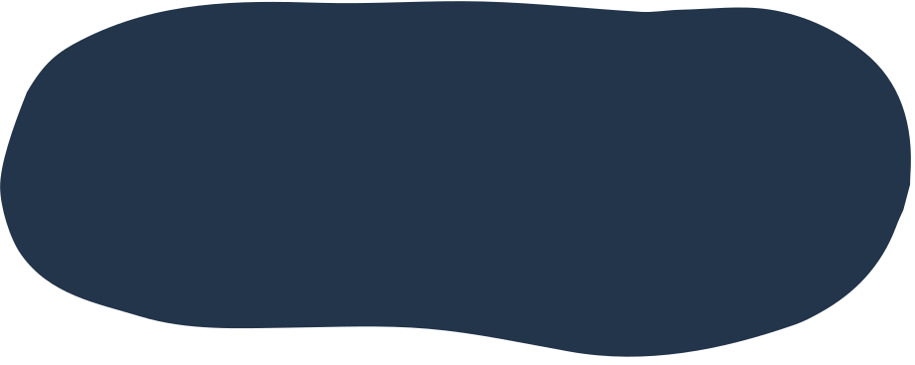
purpose of application
The main purpose of the Flappy Bird app is to provide entertainment through simple yet challenging gameplay, where the player has to control the bird from crashing into pipes by tapping the screen to keep the bird flying.
.
Flappy Bird was designed to be an easy game to play, yet difficult to master. The goal was to provide instant entertainment without taking a long time to learn the game mechanics.

Slide 4

Flappy bird gameplay
How to Play: The player must tap the screen (or press a button) to make the bird jump upwards. Each tap makes the bird flap its wings, causing it to rise slightly.
Main Objective: The goal is for the player to avoid obstacles (usually green pipes positioned at the top and bottom of the screen) and fly as far as possible without hitting the pipes or the ground. Each time the bird successfully passes through a set of pipes, the player earns one point.

Slide 5

Key Components of the Game
The Bird: The main character controlled by the player, which is affected by gravity and can jump (flap) based on player input.
Score: Players earn points each time the bird passes through the pipes. The score is displayed on the screen throughout the game.
Pipes: These are the obstacles that appear from the right side of the screen and move to the left. The gaps between the pipes vary, and the longer the player survives, the faster the pipes move.
Game Over: The game ends when the bird hits a pipe or falls to the ground. After a game over, the player can see their final score and is given the option to restart.

Slide 6
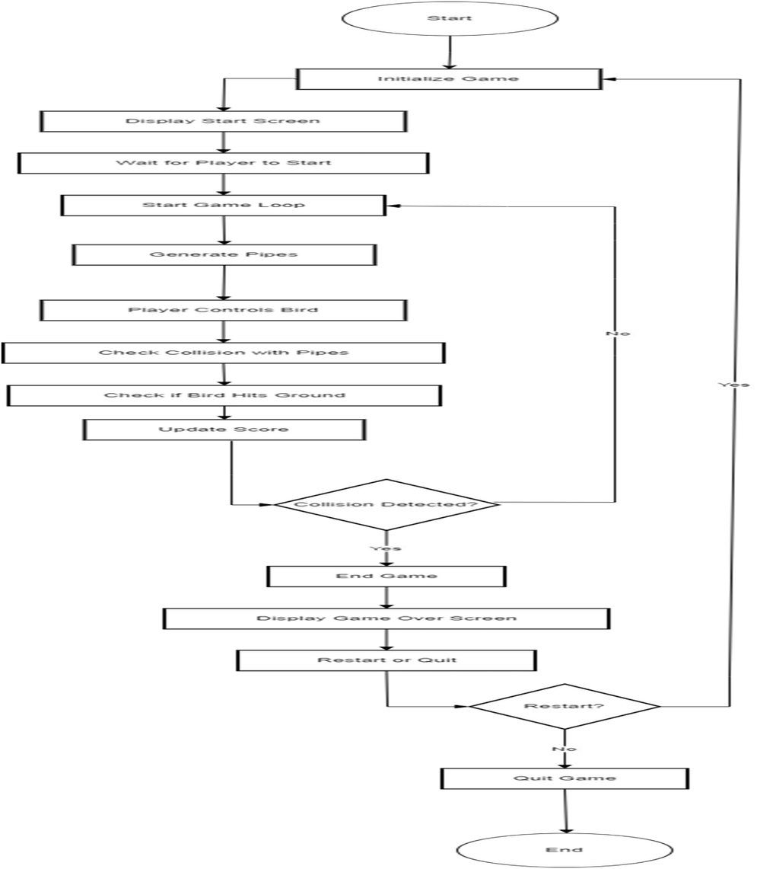
Flowchart

Slide 7



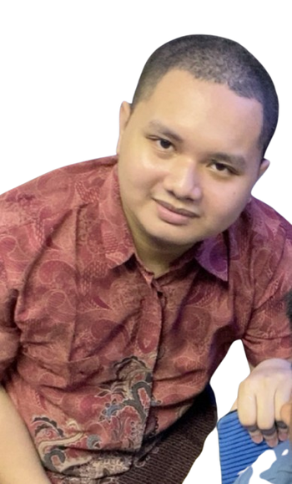

Slide 8
Terima Kasih

